Slide 1
COMPUTER SYSTEM ARCHITECTURE
PROJECT PRESENTATION
FALL 2023 CSCI 6461
DR. LEI HE
ADONIA SEQUEIRA G31345330
SHIVAM CHAVAN G22366287
VINAYAK DUBEY G47804140

Slide 2
GROUP MEMBER PRESENTATION
All the tasks were equally divided among the three group members including the execution , report and the presentation.

Slide 3
EXPERIMENT SETUP
Computer System: Lenovo Thinkpad X1 Carbon/ Microsoft azure cloud instance
Operating system: Microsoft Windows 11 Home
Simulation Software: SMPcache
Computer System: Dell Vostro 15 3510
Operating system: Windows 11 Enterprise
Simulation Software: SMPcache

Slide 4
METHODOLOGY
Enter simulation parameters
Run the simulation
Analyze the results
Configuration
Simulation
Analysis

Slide 5
PROJECT 1

Slide 6
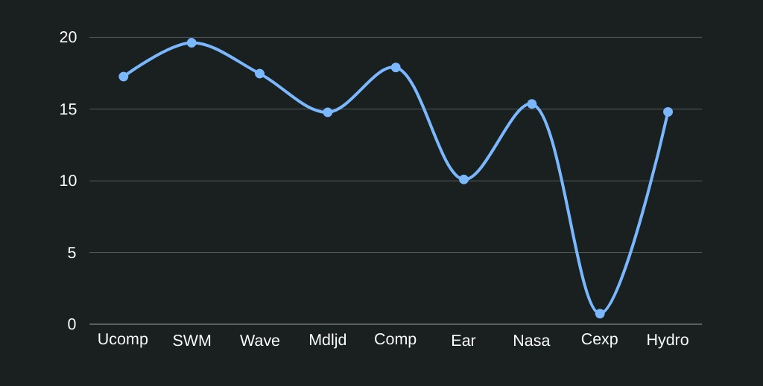
TASK 1
Show that the programs have different locality, and there are programs with “good” or “bad” locality.
CONFIGURATION:
Processors in SMP = 1.
Cache coherence protocol = MESI.
Scheme for bus arbitration = Random.
Word wide (bits) = 16.
Words by block = 16 (block size = 32 bytes).
Blocks in main memory = 8192 (main memory size = 256 KB).
Blocks in cache = 128 (cache size = 4 KB).
Mapping = Fully-Associative.
Replacement policy = LRU
PROCESSORS: Hydro, Nasa7, Cexp, Mdljd, Ear, Comp, Wave, Swm and UComp
TIME TAKEN PER EXECUTION: 2 hrs.
OBSERVATIONS:
CEXP processor had the best locality (lowest miss rate)
SWM processor had the worst locality (highest miss rate)
Enhancing locality grade enhances system performance
Higher locality grade can be achieved by using larger block sizes and caches.
Miss rate decreases as execution of the program goes forward.

Slide 7
TASK 2
Show the influence of the cache size on the miss rate.
CONFIGURATION:
Processors in SMP = 1.
Cache coherence protocol = MESI.
Scheme for bus arbitration = Random.
Word wide (bits) = 16.
Words by block = 16 (block size = 32 bytes).
Blocks in main memory = 8192 (main memory size = 256 KB).
Mapping = Fully-Associative.
Replacement policy = LRU.
PROCESSORS: Hydro, Nasa7, Cexp, Mdljd, Ear, Comp, Wave, Swm and Ucomp
BLOCKS IN CACHE: 1, 2, 4, 8, 16, 32, 64, 128, 256, and 512
TIME TAKEN PER EXECUTION: 3 hrs
OBSERVATIONS:
miss rate decreases with the increase in cache size
The miss rate depends on the locality grade taking advantage of spatial locality.
There are no conflict misses in our experiments because the cache size is increasing.

Slide 8
TASK 3
Study the influence of the block size on the miss rate.
CONFIGURATION:
Processors in SMP = 1.
Cache coherence protocol = MESI.
Scheme for bus arbitration = Random.
Word wide (bits) = 16.
Main memory size = 256 KB (the number of blocks in main memory will vary).
Cache size = 4 KB (the number of blocks in cache will vary).
Mapping = Fully-Associative.
Replacement policy = LRU.
PROCESSORS: Hydro, Nasa7, Cexp, Mdljd, Ear, Comp, Wave, Swm and Ucomp
WORDS BY BLOCKS: (block size = 8 bytes), 8, 16, 32, 64, 128, 256, 512, and 102
TIME TAKEN PER EXECUTION: 2hrs
OBSERVATIONS:
The increase of block size will improve the system performance.
The miss rate decreases as the block size increases because there are more block sizes available to utilize spatial locality.
When the block size is enlarged, the compulsory misses remain unchanged.
A bigger block size causes a higher miss penalty.
We observed the pollution point (where block size is too big as compared to the cache size) in every iteration.

Slide 9
TASK 4
Show the influence of the block size on the miss rate, but in this case, for several cache sizes.
CONFIGURATION:
Processors in SMP = 1.
Cache coherence protocol = MESI.
Scheme for bus arbitration = Random.
Word wide (bits) = 32.
Main memory size = 1024 KB (the number of blocks in main memory will vary).
Mapping = Fully-Associative.
Replacement policy = LRU.
PROCESSORS: Hydro, Nasa7, Cexp, Mdljd, Ear, Comp, Wave, Swm and Ucomp
CACHE SIZES: 4 KB, 8 KB, 16 KB, and 32 KB
TIME TAKEN PER EXECUTION: 3hrs
OBSERVATIONS:
As the size of blocks increases, there is an evident decrease in miss rates
Increasing the block size leads to a notable decrease in compulsory misses.
As the cache size increases for a given block size, the occurrence of spikes diminishes.

Slide 10
TASK 5
Analyze the influence of the mapping on the miss rate for several cache sizes.
CONFIGURATION:
Processors in SMP = 1.
Cache coherence protocol = MESI.
Scheme for bus arbitration = Random.
Word wide (bits) = 32.
Words by block = 64 (block size = 256 bytes).
Blocks in main memory = 4096 (main memory size = 1024 KB).
Replacement policy = LRU
PROCESSOR: Ear
CACHE SIZES: 4 KB, 8 KB, 16 KB, and 32 KB
MAPPING: Direct, two-way set associative, four-way set associative, eight-way set associative, and fully-associative
TIME TAKEN PER EXECUTION: 2hrs
OBSERVATIONS:
increasing associativity improves system performance.
When associativity advances, the miss rate decreases.
As cache capacity increases, the associative grade drops because advantages get shorter.
The transition from direct to 2-way set associative is the most advantageous.

Slide 11
TASK 6
Show the influence of the replacement policy on the miss rate.
CONFIGURATION:
Processors in SMP = 1.
Cache coherence protocol = MESI.
Scheme for bus arbitration = Random.
Word wide (bits) = 16.
Words by block = 16 (block size = 32 bytes).
Blocks in main memory = 8192 (main memory size = 256 KB).
Blocks in cache = 128 (cache size = 4 KB).
Mapping = 8-way set-associative (cache sets = 16).
PROCESSOR: Hydro, Nasa7, Cexp, Mdljd, Ear, Comp, Wave, Swm and UComp.
BLOCKS IN CACHE: 1 (cache size = 0,03 KB), 2, 4, 8, 16, 32, 64, 128, 256, and 512
TIME TAKEN PER EXECUTION: 2 hrs
OBSERVATIONS:
The Least Recently Used (LRU) policy appears to be the most effective replacement strategy.
Random stands out as the least effective replacement policy.
the advantages offered by LFU and FIFO vary across different benchmarks.
The utilization of various replacement policies does not yield differing miss rate outcomes.
A specific replacement policy can enhance system performance

Slide 12
PROJECT 2
We have performed Task 5 and 6 for extra credits.
Additionally for all tasks we have used 8 processors

Slide 13
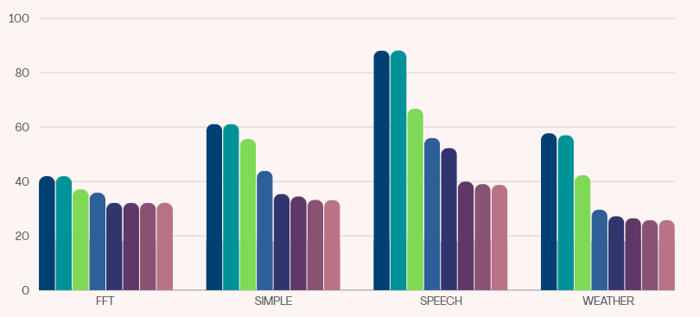
TASK 1
Study the influence of the cache size on the miss rate during the execution of a parallel program in a SMP
CONFIGURATION:
Processors in SMP = 8.
Cache coherence protocol = MESI.
Scheme for bus arbitration = LRU.
Word wide (bits) = 16.
Words by block = 32 (block size = 64 bytes).
Blocks in main memory = 524288 (main memory size = 32 MB).
Mapping = Set-Associative.
Cache sets = They will vary depending on the number of blocks in cache
Replacement policy = LRU.
PROCESSOR: FFT, Simple, Speech and Weather.
BLOCKS IN CACHE: 1 (cache size = 0,03 KB), 2, 4, 8, 16, 32, 64, 128, 256, 512, 1024, and 2048
TIME TAKEN PER EXECUTION: 12 hrs
OBSERVATIONS:
The global miss rate decreases as cache size increases.
The miss rate is affected by the locality grade since larger cache sizes benefit from spatial locality.
Capacity and conflict misses were decreasing. The compulsory miss rate component remains constant as cache size is increased
Since the compulsory miss is independent of cache size, the degree of misses stabilizes at large cache sizes.
The total cache size rises as we increase the number of processors.
Colors represent different block sizes
Miss Rate %

Slide 14
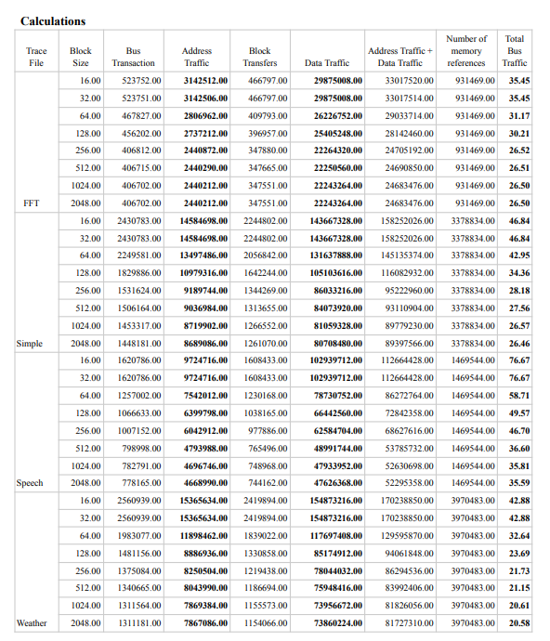
TASK 2
Show the influence of the cache size on the bus traffic during the execution of a parallel program in a SMP.
CONFIGURATION:
Processors in SMP = 8.
Cache coherence protocol = MESI.
Scheme for bus arbitration = LRU.
Word wide (bits) = 16.
Words by block = 32 (block size = 64 bytes).
Blocks in main memory = 524288 (main memory size = 32 MB).
Mapping = Set-Associative.
Cache sets = They will vary depending on the number of blocks in cache
Replacement policy = LRU.
PROCESSOR: FFT, Simple, Speech and Weather.
BLOCKS IN CACHE: 1 (cache size = 0,03 KB), 2, 4, 8, 16, 32, 64, 128, 256, 512, 1024 & 2048
TIME TAKEN PER EXECUTION: 12 hrs
OBSERVATIONS:
As cache size increases, bus traffic reduces.
For great cache sizes, the bus traffic is stabilized.
Bus transaction rate, address, data, bus traffic, and miss rate all drop as the cache size increases.
Total Bus Traffic

Slide 15
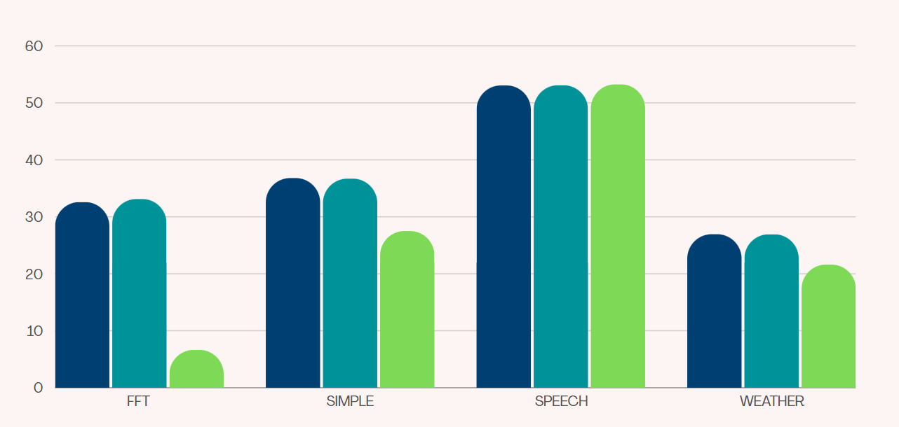

TASK 3
Influence of the Cache Coherence Protocol on the Miss Rate
CONFIGURATION:
Processors in SMP = 8.
Scheme for bus arbitration = LRU.
Word wide (bits) = 16.
Words by block = 32 (block size = 64 bytes).
Blocks in main memory = 524288 (main memory size = 32 MB).
Blocks in cache = 256 (cache size = 16 KB).
Mapping = Set-Associative.
Cache sets = 64 (four-way set associative caches).
Replacement policy = LRU
PROCESSOR: FFT, Simple, Speech and Weather.
CACHE COHERENCE PROTOCOLS: MSI, MESI, and DRAGON.
TIME TAKEN PER EXECUTION: 10 hrs
OBSERVATIONS:
Dragon has the lowest and the best miss rate.
Not all protocols have the same miss rate.
MSI and MESI have similar miss rate but not the same miss rate.
We observe a difference between the update-based protocol and invalidation based protocols.
Update based protocol experience fewer coherence misses.
Conclusion, The choice of benchmarks significantly influences the memory access patterns and, consequently, the miss rate.
Miss Rate %

Slide 16
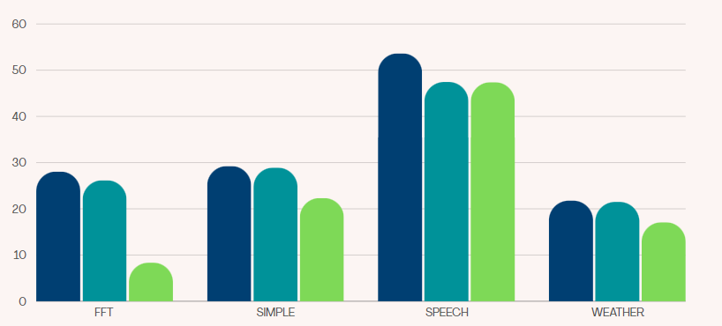
TASK 4
Influence of the Cache Coherence Protocol on the Bus Traffic
CONFIGURATION:
Processors in SMP = 8.
Scheme for bus arbitration = LRU.
Word wide (bits) = 16.
Words by block = 32 (block size = 64 bytes).
Blocks in main memory = 524288 (main memory size = 32 MB).
Blocks in cache = 256 (cache size = 16 KB).
Mapping = Set-Associative.
Cache sets = 64 (four-way set associative caches).
Replacement policy = LRU.
PROCESSOR: FFT, Simple, Speech and Weather.
CACHE COHERENCE PROTOCOLS: MSI, MESI, and DRAGON.
TIME TAKEN PER EXECUTION: 10 hrs
OBSERVATIONS:
The DRAGON protocol exhibits the lowest bus traffic
Not all protocols have same bus traffic.
The least favorable ones are associated with MSI and MESI memory traces.
The bus traffic for MSI and MESI protocols is nearly identical.
Conclusion, increase in the number of processors for a parallel application leads to higher miss rates and bus traffic.
Total Bus Traffic

Slide 17
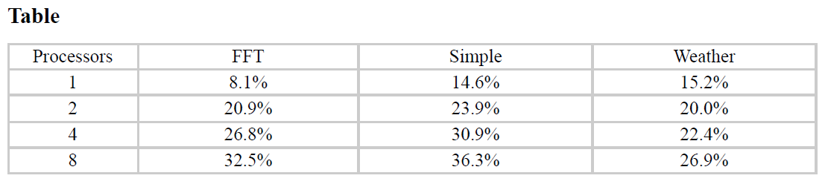
TASK 5
Influence of the Number of Processors on the Miss Rate
CONFIGURATION:
Cache coherence protocol = MESI.
Scheme for bus arbitration = LRU.
Word wide (bits) = 16.
Words by block = 32 (block size = 64 bytes).
Blocks in main memory = 524288 (main memory size = 32 MB).
Blocks in cache = 256 (cache size = 16 KB).
Mapping = Set-Associative.
Cache sets = 64 (four-way set associative caches).
Replacement policy = LRU.
PROCESSOR: FFT, Simple, and Weather.
NUMBER OF PROCESSORS: 1, 2, 4, and 8
TIME TAKEN PER EXECUTION: 15 hrs
OBSERVATIONS:
The global miss rate rises with an escalation in the number of processors.
As multiple processors access the same data, the likelihood of a cache miss increases.
The effectiveness of this improvement hinges on the availability of sufficient bus bandwidth.
Miss Rate %

Slide 18
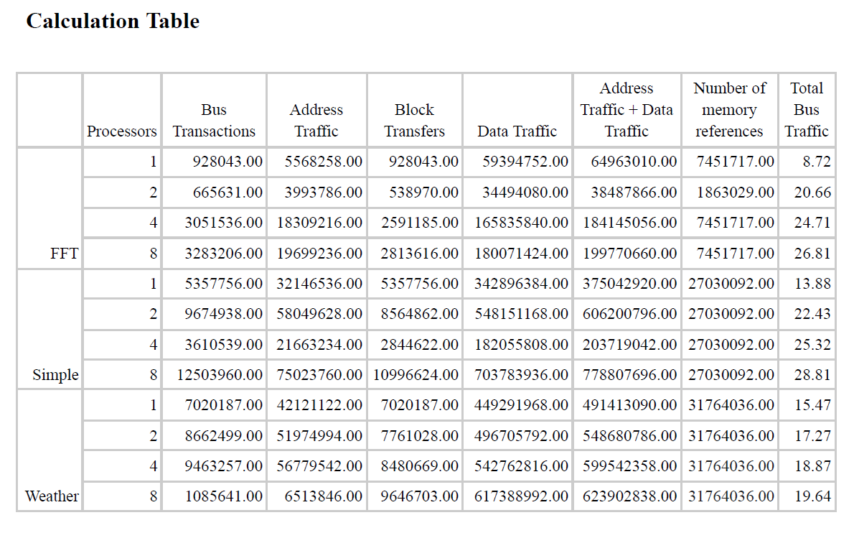
TASK 6
Influence of the Number of Processors on the Bus Traffic
CONFIGURATION:
Cache coherence protocol = MESI.
Scheme for bus arbitration = LRU.
Word wide (bits) = 16.
Words by block = 32 (block size = 64 bytes).
Blocks in main memory = 524288 (main memory size = 32 MB).
Blocks in cache = 256 (cache size = 16 KB).
Mapping = Set-Associative.
Cache sets = 64 (four-way set associative caches).
Replacement policy = LRU.
PROCESSOR: FFT, Simple, and Weather.
NUMBER OF PROCESSORS: 1, 2, 4, and 8
TIME TAKEN PER EXECUTION: 15 hrs
OBSERVATIONS:
The global bus traffic increases with an increasing number of processors due to high parallelism and coordination demands
The choice of cache coherence protocol plays a crucial role in determining how processors interact and coordinate their access to shared data.
The step with the most bus traffic occurs from 1 to 2 processors
Total Bus Traffic

